Slide 1

1

Slide 2
A robot is a programmable mechanical device that can perform tasks and interact with its environment, without the direct aid of human interaction.
Components of a Robot
Links: The mechanical element which makes the body of the robot
Joints: It connects the mechanical elements; active joint or passive joint
Motors/drive trains: Active joints will have motors in it; that drives the robot
Control systems: It controls the actuation of the motors

Slide 3
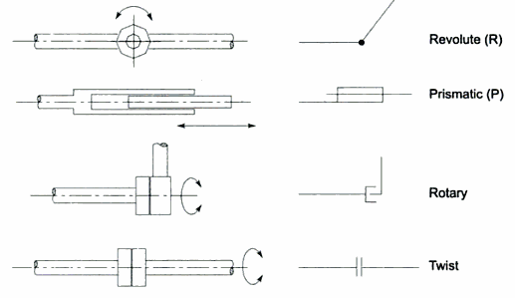
Types of joints
Revolute joint: Joined by a pin and links can rotate with
respect to each other.
Prismatic joint: The two links can slide/linearly move
with respect to each other.
Rotary joint: One link rotates about the other at 90º angle
Twist joint: Two links remain aligned, but one twists
about the axis of the other.
Source: Robotics and control, by Nagrath and Mittal

Slide 4
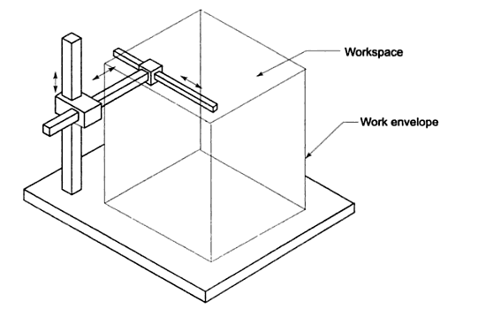
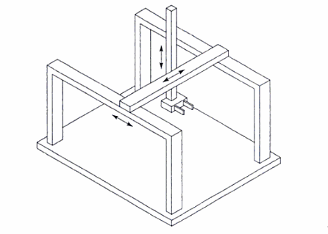
Classification of industrial robots
1. Cartesian manipulator

Slide 5
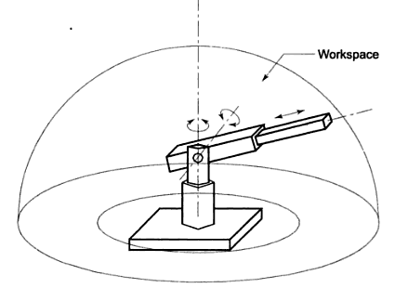
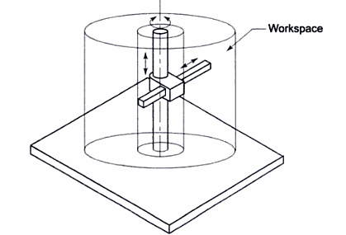
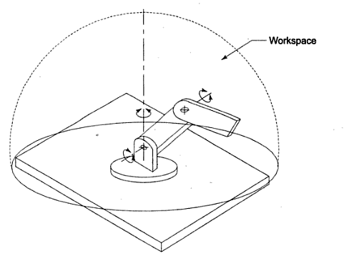
2. Cylindrical manipulator
3. Spherical manipulator
4. Articulated manipulator

Slide 6
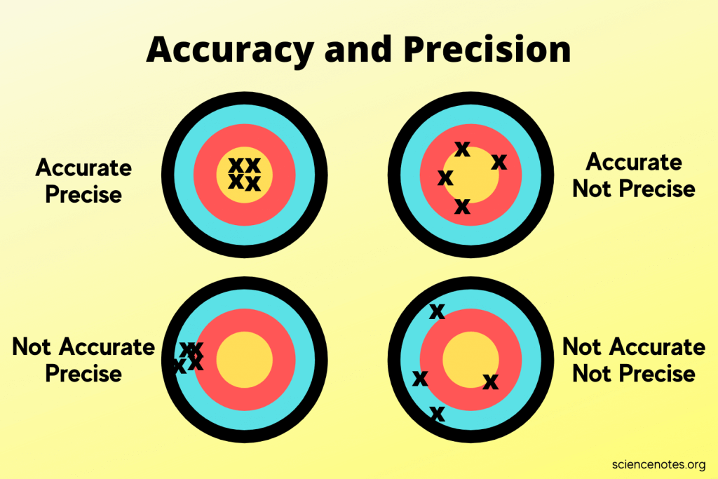
Precision is a function of three things
Spatial resolution
Accuracy and
Repeatability
Normally accuracy and precision
are defined as shown in the
figure aside.
https://sciencenotes.org/what-is-the-difference-between-accuracy-and-precision/

Slide 7
Spatial resolution: It is the smallest increment of movement into which the robot
can divide its work volume. It depends upon two factors: the system’s control resolution
and the robots mechanical inaccuracy.
Control resolution is the controller’s ability to divide the total range of movement of a
particular joint into individual increment that can be addressed in the controller.
Mechanical inaccuracy is due to gear backlash, stretching of pulley cords, elastic
deflection of structural members etc.
If a robot’s control memory has 12 bit storage capacity, then its control resolution for a
sliding joint having full range of 500 mm is 500/2¹²=.122mm.
This is the control resolution of one joint; a robot consists of several joints. And the
overall control resolution will be the vectorial addition of individual control resolution of
all the joints.

Slide 8
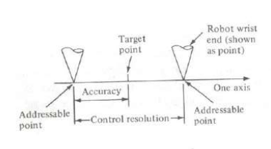
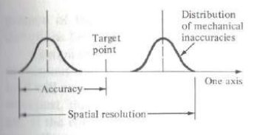
In the figure aside, target point is at the
middle of the control resolution which
is the minimal increment a robot can
have. Here mechanical inaccuracy is
Ignored.
In the bottom figure, spatial resolution with
mechanical inaccuracy is shown. Also
shown accuracy.

